Slide 1

UNIVERSITY COLLEGE OF ENGINEERING
DEPARTMENT OF COMPUTER SCIENCE AND ENGINEERING
Development of Web application for Regional Virtual Fair
Under the esteemed guidance of
Mr. DASU
Assistant Professor
Presented By
THURBILLI KARTHIK
2182951042
II MCA

Slide 2
Contents
Abstract
Existing System
Proposed System
Software & Hardware Requirements
Functional Requirements
Non-Functional Requirements
System Architecture
UML Diagrams
Implementation And Output Screens
Conclusion
References

Slide 3
Abstract
E-commerce has revolutionized the way people buy and sell products and services, and the building materials industry is no exception. E-commerce platforms for building materials allow customers to browse a catalog of products and find exactly what they need, like cement, iron, bricks materials. Even then customers are preferring for an online source. Now my Idea in this project that it will help the customers to find the products at reasonable prices in their local regions which can ensure the trust in them.
Convenience and ease of use: E-commerce platforms enable customers to purchase building materials from the comfort of their own homes or offices, saving them time and effort.
Lower prices: E-commerce platforms often offer competitive prices for building materials, as they can source products from multiple areas.
Sustainability: E-commerce platforms for building materials can help to reduce the carbon footprint of the construction industry, as they enable customers to order products online and have them delivered directly to the construction site, rather than having to transport them from a physical store.
Keywords : Accessible, E-commerce, Carbon footprint, Sustainability, Regions.

Slide 4
Existing System
The existing system consists of Current materials management practices in the construction industry are performed on fragmented basis with unstructured communication and no clearly established responsibilities between the parties involved.
The highly fragmentation is a result of the separation of design and construction, lack of coordination and integration between various functional disciplines, poor communication, etc.
DISADVANTAGES:
Can’t get correct prices.
Time taken process
Loss the money and increases overheads.

Slide 5
Proposed System
The aim of this application is to develop a framework for the best practice of material supply chain process through the project phases that suits the local construction industry in order to help customers to have the right materials in the right quantities (at the right place) at the right moment at minimal cost so they can improve their productivity, minimize losses and increase competitiveness
ADVANTAGES:
Simple and easy to operate.
Mobile access, anytime, anywhere.
Saves time/money and reduces overheads.

Slide 6
System Requirements
Software Requirements:
Operating system: Windows 11
Programming language: HTML, CSS, JavaScript, PHP.
IDE: Visual Studio.
Frame work : jQuery.
Softwares : WAMP/ XAMPP.
Libraries :Paytm Payment Gateway, Tawk.to.
Server: Apache.
Database: MySQL.
Other Requirements: Any web browser.

Slide 7
System Requirements
Hardware Requirements:
Processor : i3/i5
RAM : 8 GB
Hard Disk : 512 GB/1 TB

Slide 8
Functional and Non-Functional Requirements
Requirements analysis is very critical process that enables the success of a system or software project to be assessed. Requirements are generally split into two types: Functional and Non-functional requirements.
Functional Requirements:
These are the requirements that the end user specifically demands as basic facilities that the system should offer. All these functionalities need to be necessarily incorporated into the system as a part of the contract. These are represented or stated in the form of input to be given to the system, the operation performed and the output expected. They are basically the requirements stated by the user by which one can see directly in the final product, unlike the nonfunctional requirements.

Slide 9
Functionalities of Seller:
Seller has to register.
Developer gives admin rights to seller.
Login: after the email verification the vendor can be able to perform operations (like add, update, delete on their products sheet).
Manage the password.
Seller Can reply to Customer s queries on website messenger.
Seller receive the payments using payment gateway
View the data pervious orders, payments, and view the Customer ’s data.
Logout.

Slide 10
Functionalities of Customer :
Here the Customer has to register.
Login after the email verification gives access to the customer .
Before the login the customer can view the products catalog.
Customer s can ask the quires using website messenger and call/Email option.
Based on location selected product rates will be displayed.
Customer can order/checkout the products.
Customer can pay for the products using UPI in website.
Customer can view all the orders, payment status and their profile.
Logout.

Slide 11
Non-Functional Requirements:
These are basically the quality constraints that the system must satisfy according to the project contract. The priority or extent to which these factors are implemented varies from one project to other. They are also called non-behavioral requirement.
• Security: The system would provide access to only legitimate users. It will be secure on network and only authorized person can use it.
• Ease of Use: The proposed system would be user-friendly and would provide Graphical User Interface (GUI).
• Accessibility: The proposed system would be GUI-based desktop application installed on computing root node (server) running the application.
• Maintainability: The proposed system would be easy to maintain and extend. Minor modification to the system would not cause harm to the running application.

Slide 12
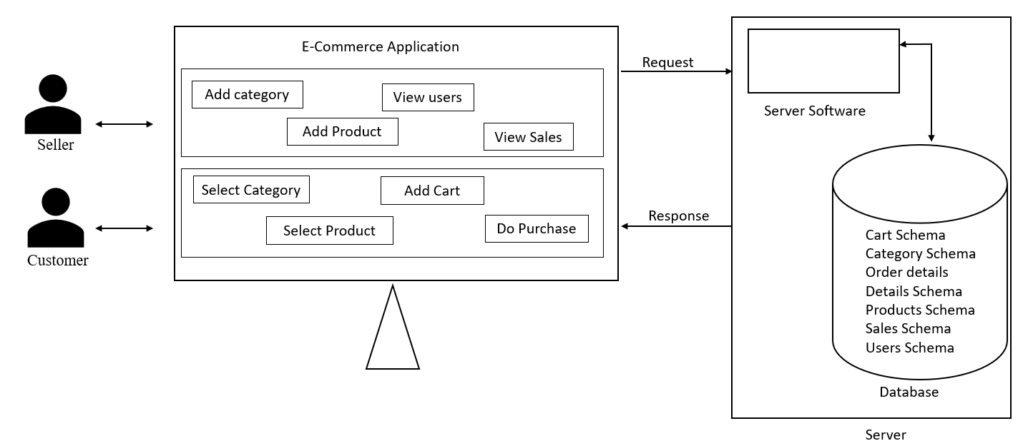
System Architecture Diagram

Slide 13
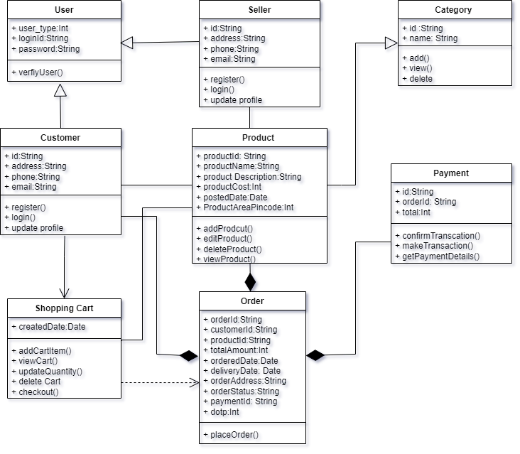
UML Diagrams
Class Diagram

Slide 14
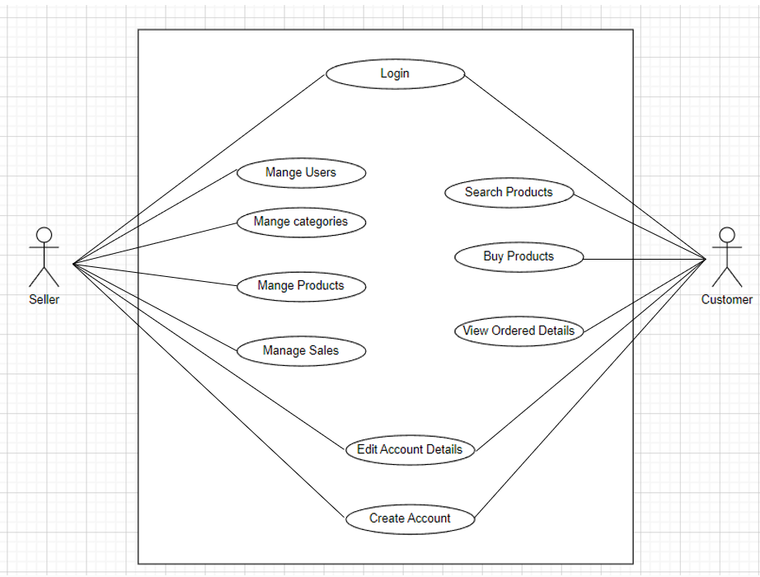
Use case Diagram

Slide 15
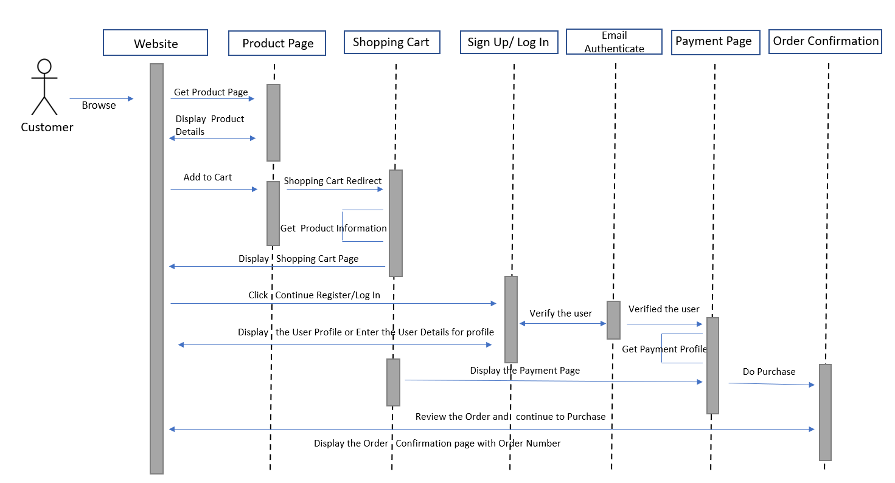
Customer Sequence Diagram:

Slide 16
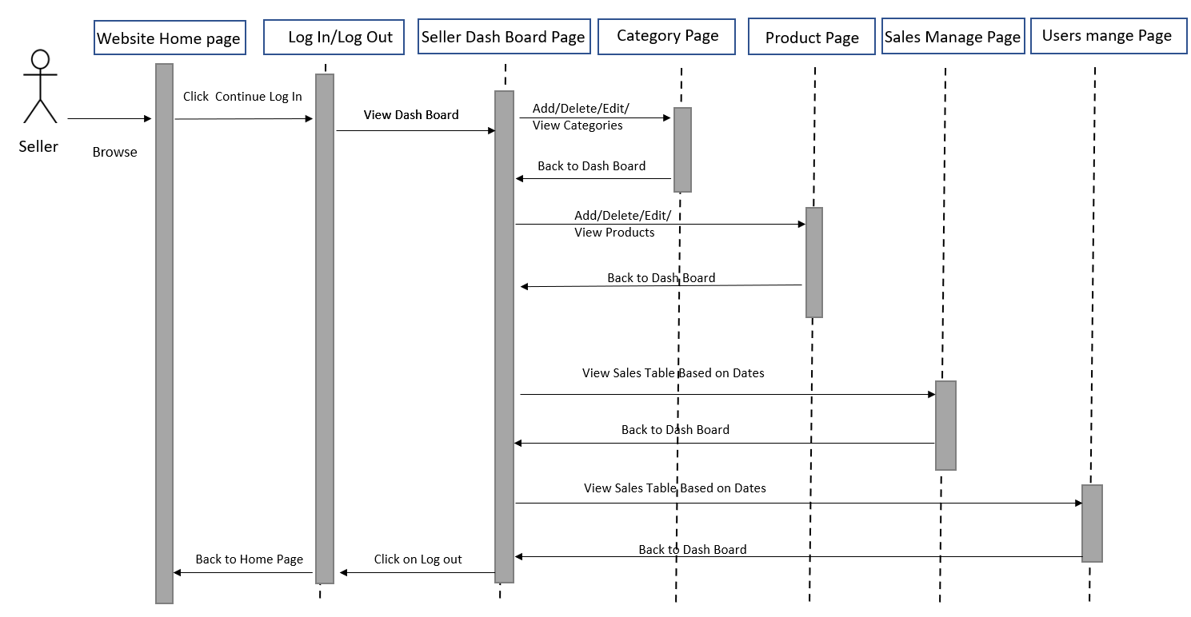
Seller Sequence Diagram:

Slide 17
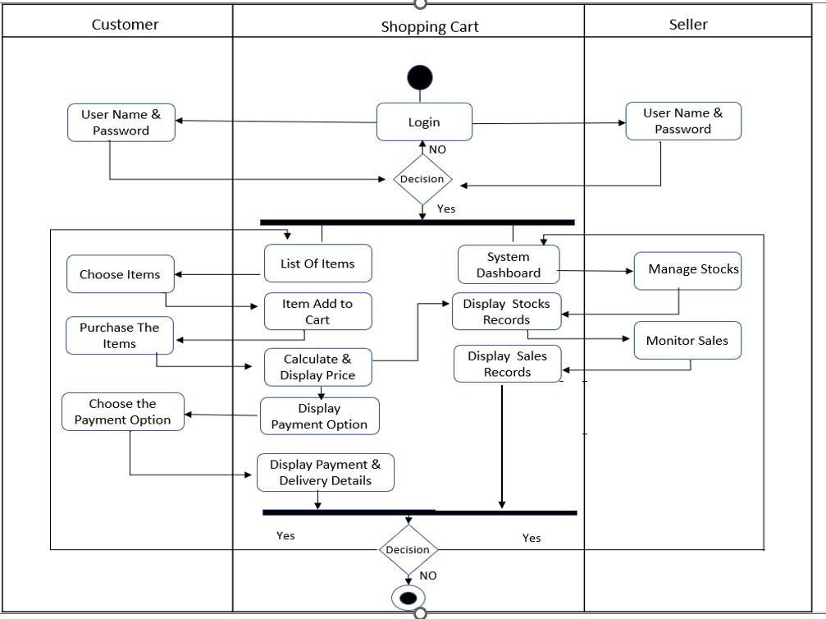
Activity Diagram

Slide 18
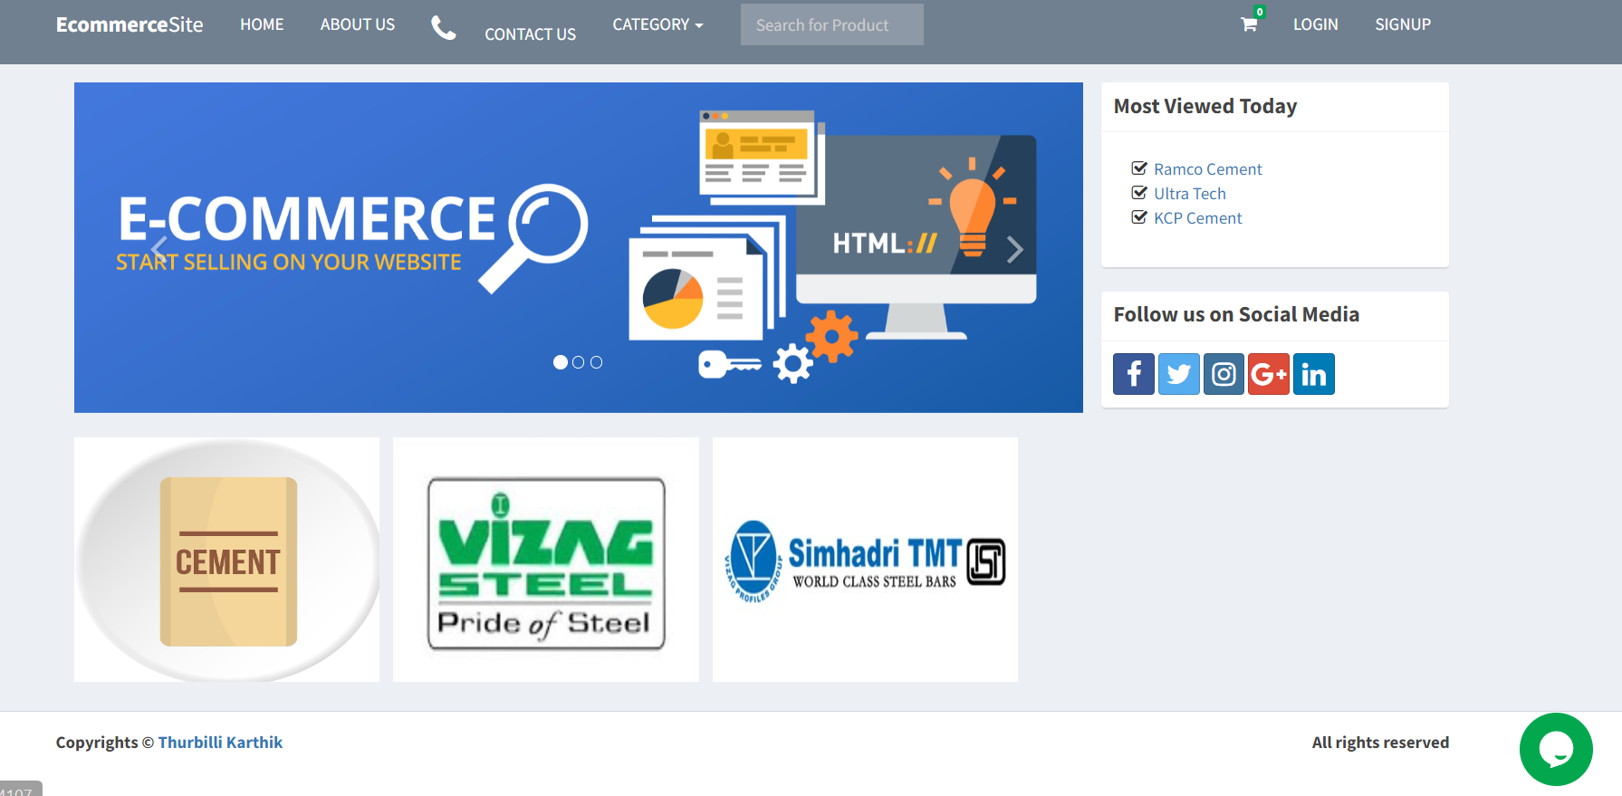
Implementation and Output Screens:
Basic Home Page:

Slide 19
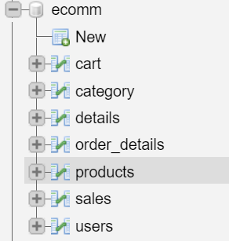
Database Structure:
Database Connection
<?php
Class Database{
private $server = "mysql:host=localhost;dbname=ecomm";
private $username = "root";
private $password = "";
private $options = array(PDO::ATTR_ERRMODE => PDO::ERRMODE_
EXCEPTION,PDO::ATTR_DEFAULT_FETCH_MODE => PDO::FETCH_ASSOC,);
protected $conn;
public function open(){try{
$this->conn = new PDO($this->server, $this->username, $this->password, $this->options);
return $this->conn; }
catch (PDOException $e){
echo "There is some problem in connection: " . $e->getMessage();
}
}
public function close(){
$this->conn = null;
}
}
$pdo = new Database();
?>

Slide 20
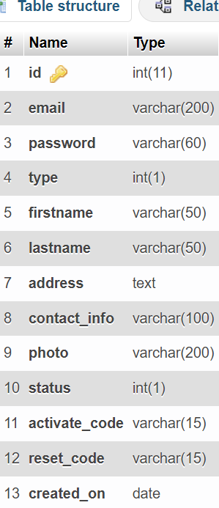
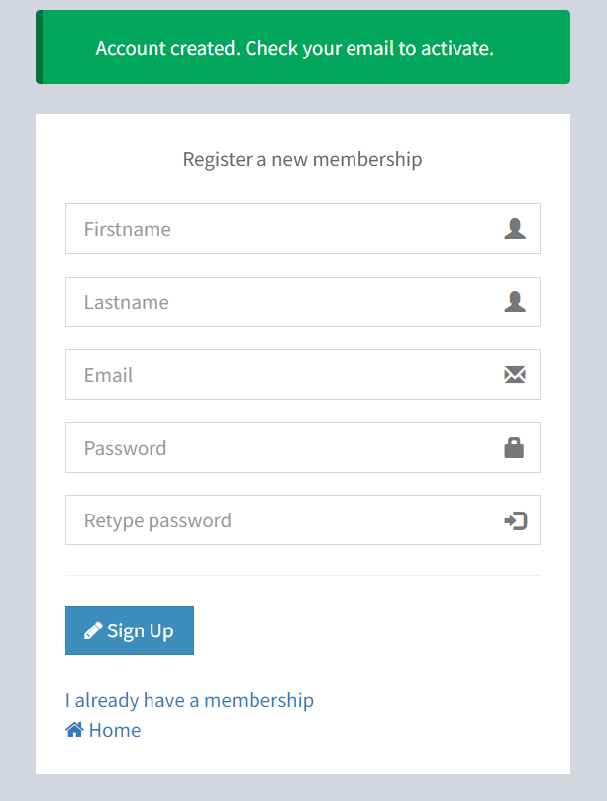
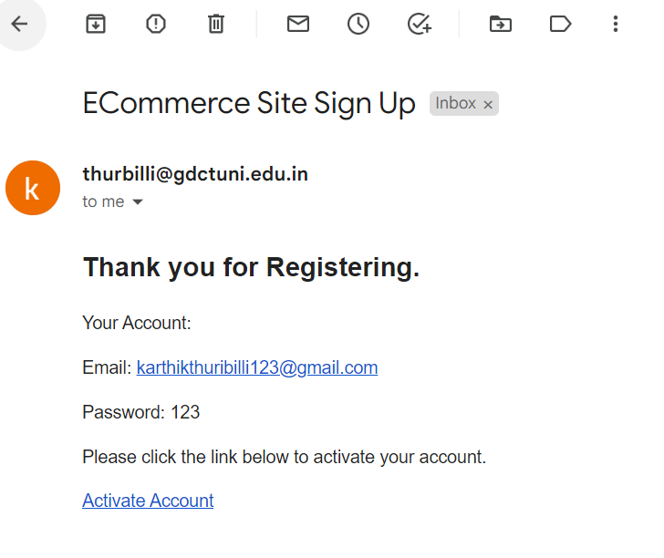
User Registration Page:
Email :
User Table Structure :

Slide 21
User Registration Page& Mail Sending Code:
try{
$stmt = $conn->prepare("INSERT INTO users(email, password,
type, firstname, lastname, activate_code, created_on) VALUES
(:email, :password,:type, :firstname, :lastname, :code, :now)");
$stmt->execute(['email'=>$email, 'password'=>$password,
'type'=>$type, 'firstname'=>$firstname, 'lastname'=>$lastname,
'code'=>$code, 'now'=>$now]);$userid = $conn->lastInsertId();
$message=“<p>Your Account:</p>
<p>Email: ".$email."</p>
<p>Password: ".$_POST['password']."</p>
<p>Please click the link below to activate your account.</p>
<a href='http://localhost/ecommerce/activate.php?
code=".$code."&user=".$userid.“’>Activate Account</a>";
require 'vendor/autoload.php’;// PHP Mailer
$mail = new PHPMailer(true);
try {
$mail->isSMTP(); //Server settings
$mail->Host = 'smtp.gmail.com';
$mail->SMTPAuth = true;
$mail->Username = 'thurbilli@gdctuni.edu.in';
$mail->Password = 'aqwlxwmidgdyuzfu';
$mail->SMTPOptions = array(
'ssl' => array(
'verify_peer' => false,
'verify_peer_name' => false,
'allow_self_signed' => true));
$mail->SMTPSecure = 'ssl';
$mail->Port = 465;
$mail->setFrom('thurbilli@gdctuni.edu.in');
//Recipients
$mail->addAddress($email);
$mail->addReplyTo('thurbilli@gdctuni.edu.in');
//Content
$mail->isHTML(true);
$mail->Subject = 'ECommerce Site Sign Up';
$mail->Body = $message;
$mail->send();
unset($_SESSION['firstname']);
unset($_SESSION['lastname']);
unset($_SESSION['email']);
$_SESSION['success'] = 'Account created. Check your email to activate.';
header('location: signup.php');}
catch (Exception $e) {
$_SESSION['error'] = 'Message could not be sent. Mailer Error:
'.$mail->ErrorInfo;
header('location: signup.php');}}
catch(PDOException $e){
$_SESSION['error'] = $e->getMessage();
header('location: register.php’);}
catch(PDOException $e){
$_SESSION['error'] = $e->getMessage();
header('location: register.php');}

Slide 22
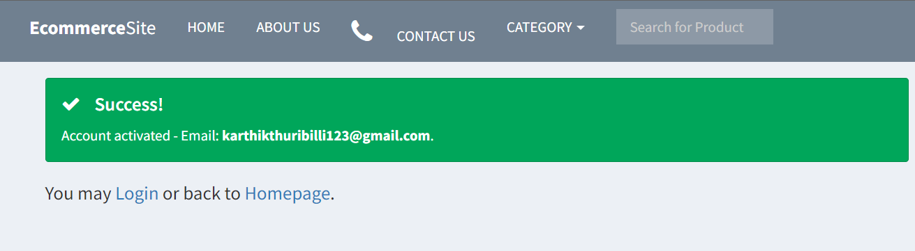
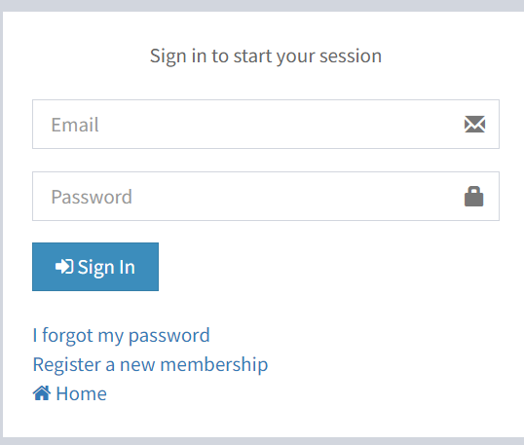
Login Page & Code:
try{
$stmt = $conn->prepare("SELECT *, COUNT(*) AS numrows FROM
users WHERE email = :email");
$stmt->execute(['email'=>$email]);
$row = $stmt->fetch();
if($row['numrows'] > 0){
if($row['status']){
if(password_verify($password, $row['password'])){
if($row['type']){
$_SESSION['Seller'] = $row['id'];}
else{
$_SESSION['user'] = $row['id'];}}
else{
$_SESSION['error'] = 'Incorrect Password';}}
else{
$_SESSION['error'] = 'Account not activated.';}}
else{
$_SESSION['error'] = 'Email not found';}}
catch(PDOException $e){
echo "There is some problem in connection: " . $e->getMessage();}

Slide 23
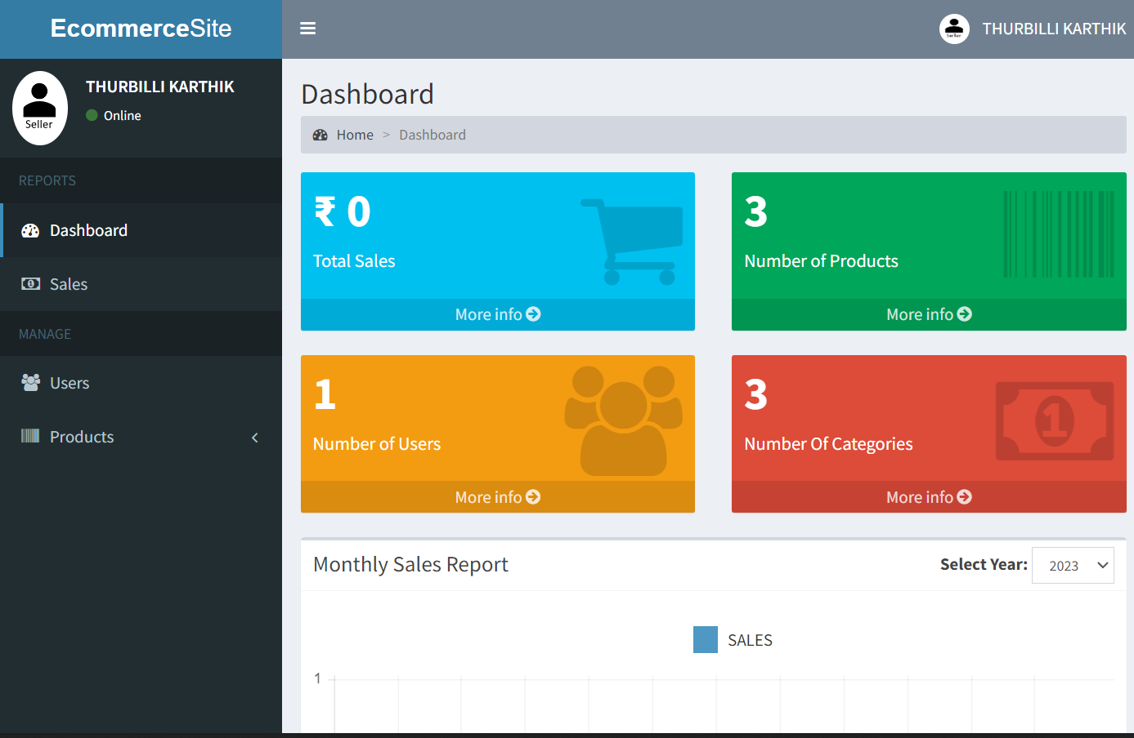
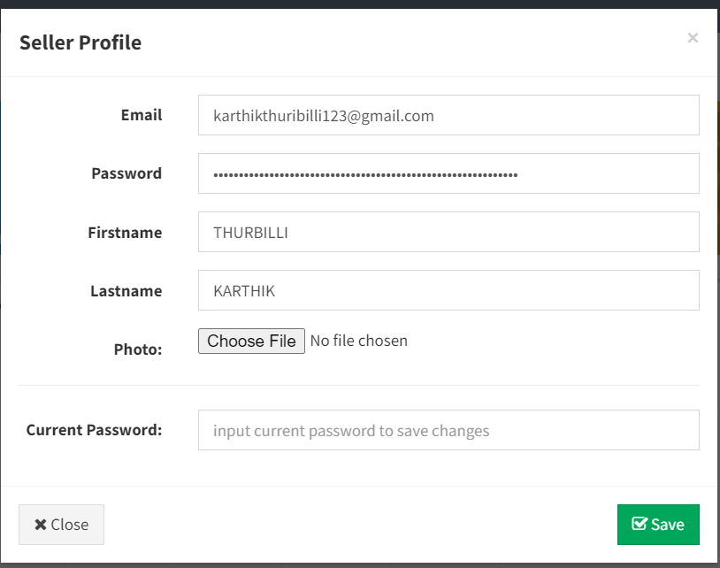
Seller Dash Board and Profile Edit:

Slide 24
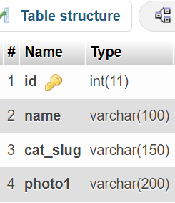
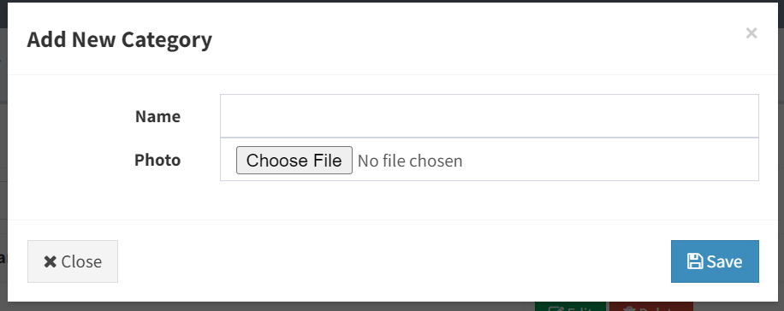
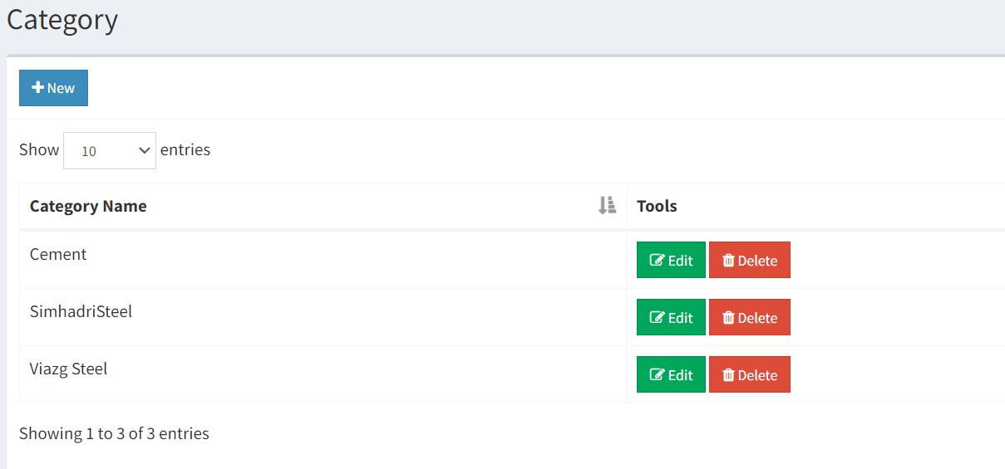
Category Table Structure
Seller/Home/Category:

Slide 25
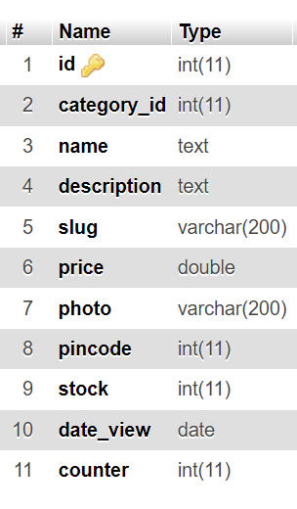
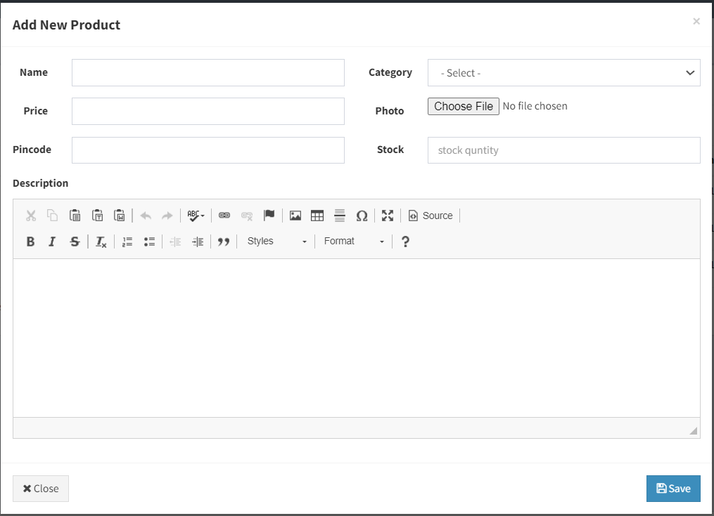
Products Table Structure
Seller/Home/Products/Product Add:

Slide 26
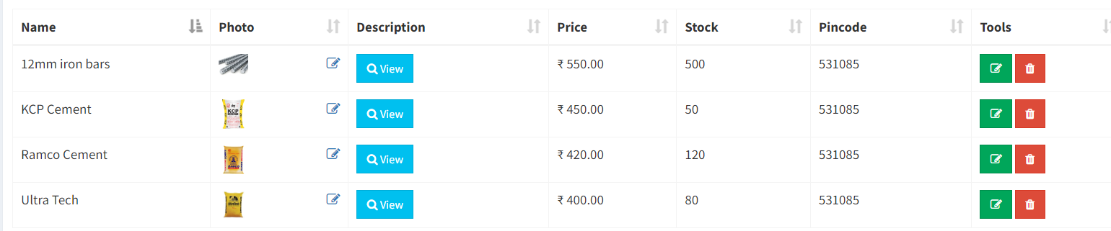
Seller/Home/Products/Product List:
Seller/Home/Users:

Slide 27
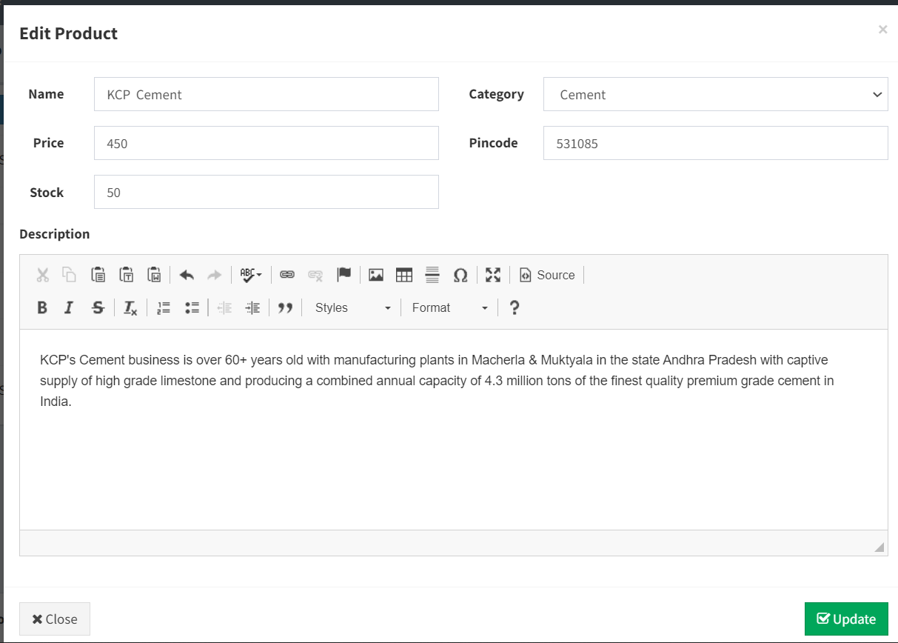
Seller/Home/Products/Product Edit:

Slide 28
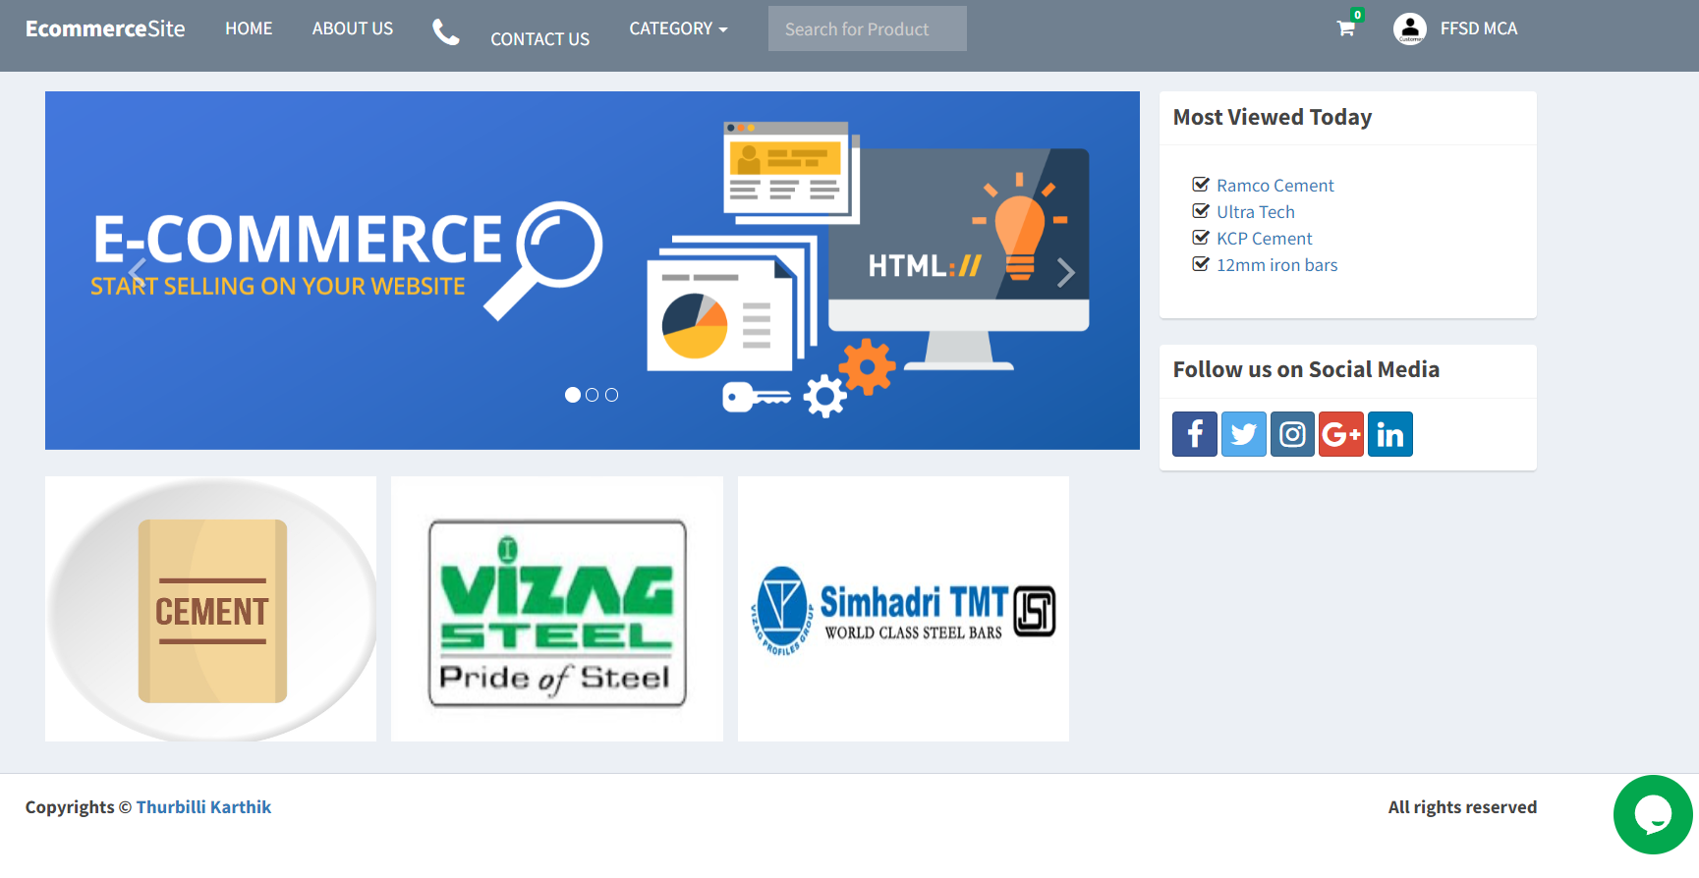
Customer Home:

Slide 29
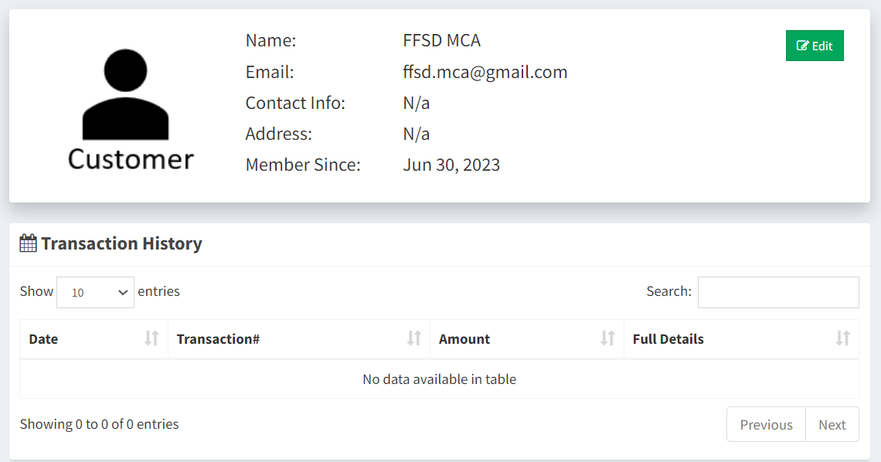
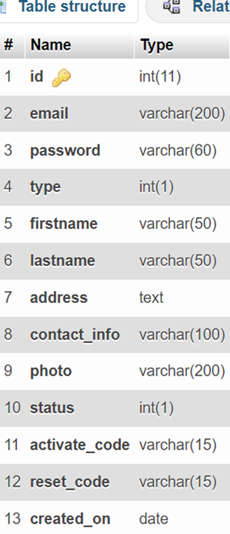
Customer /Home/Profile:
Users Table Structure

Slide 30
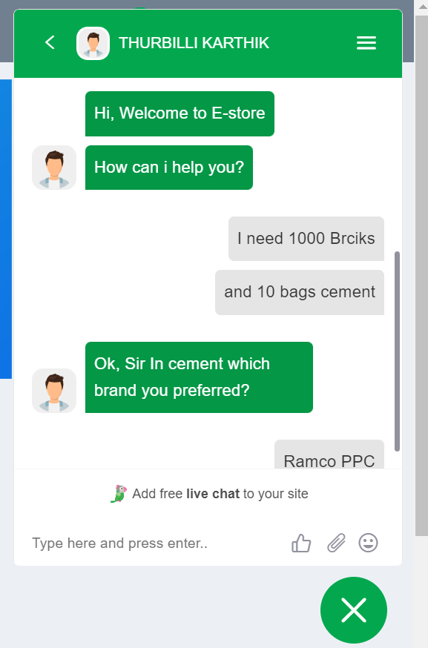
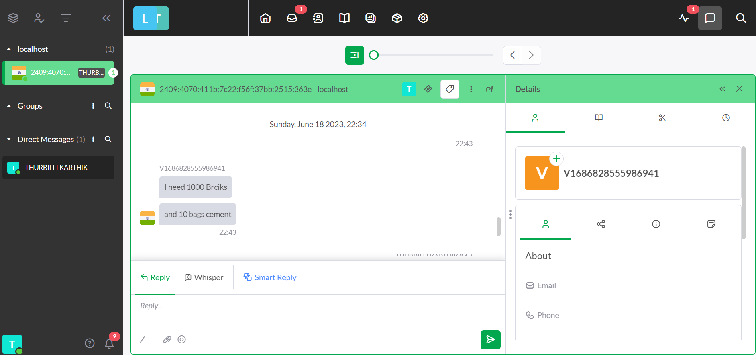
Seller Live Chat:
Customer Live Chat:

Slide 31
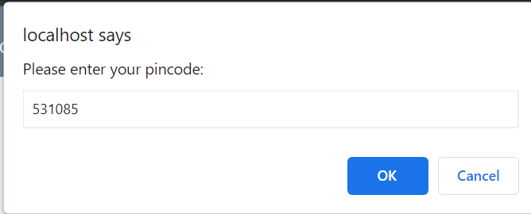
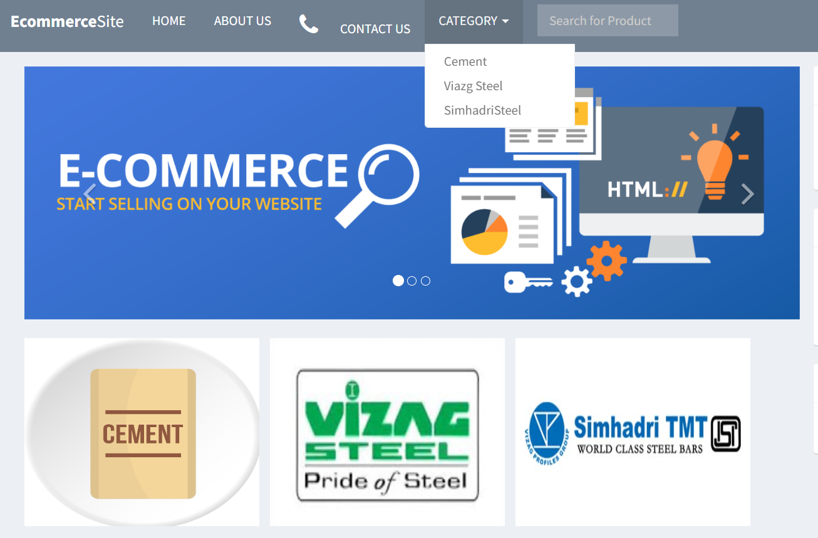
Customer /Home/Select Category:

Slide 32
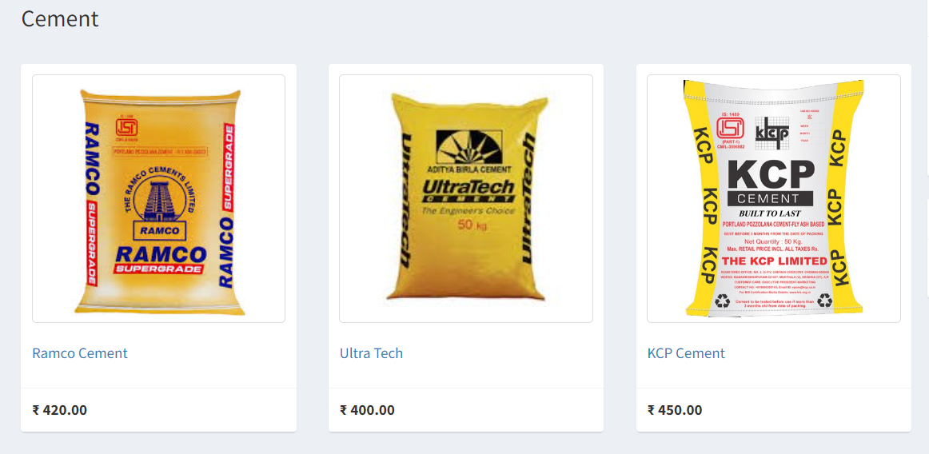
Customer /Home/Products/Cement:

Slide 33
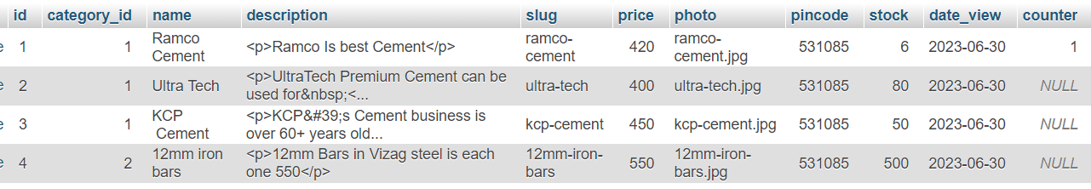
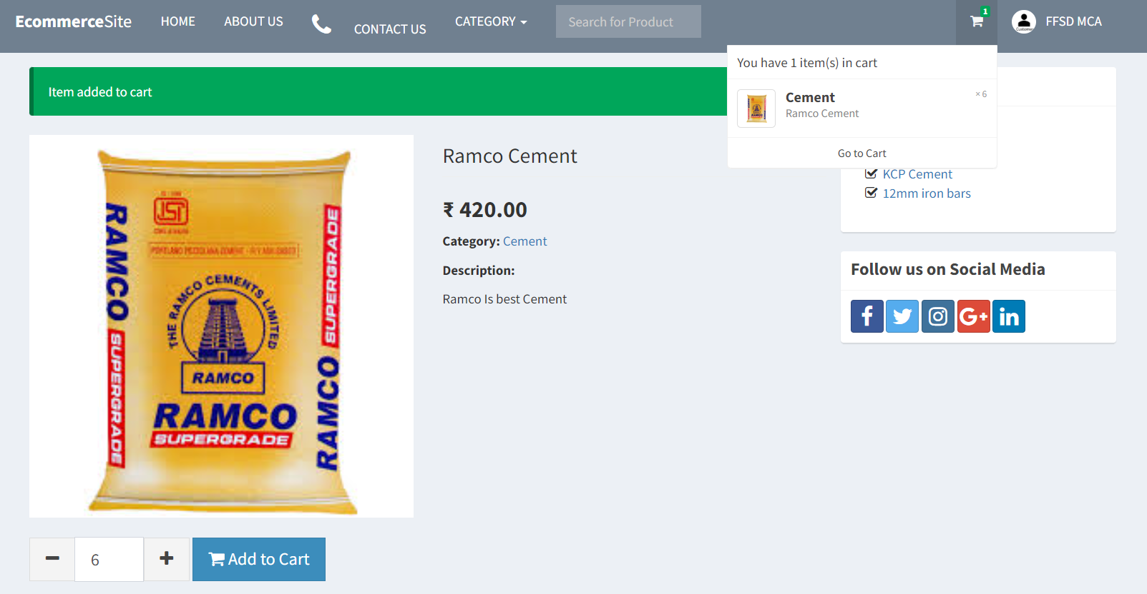
Customer /Home/Products/Cement/Add Cart:

Slide 34
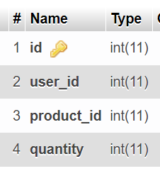
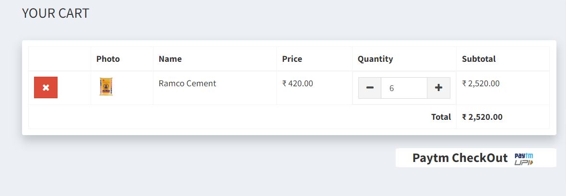
Customer /Home/Products/Cement/Cart Data:
Cart Table Structure

Slide 35
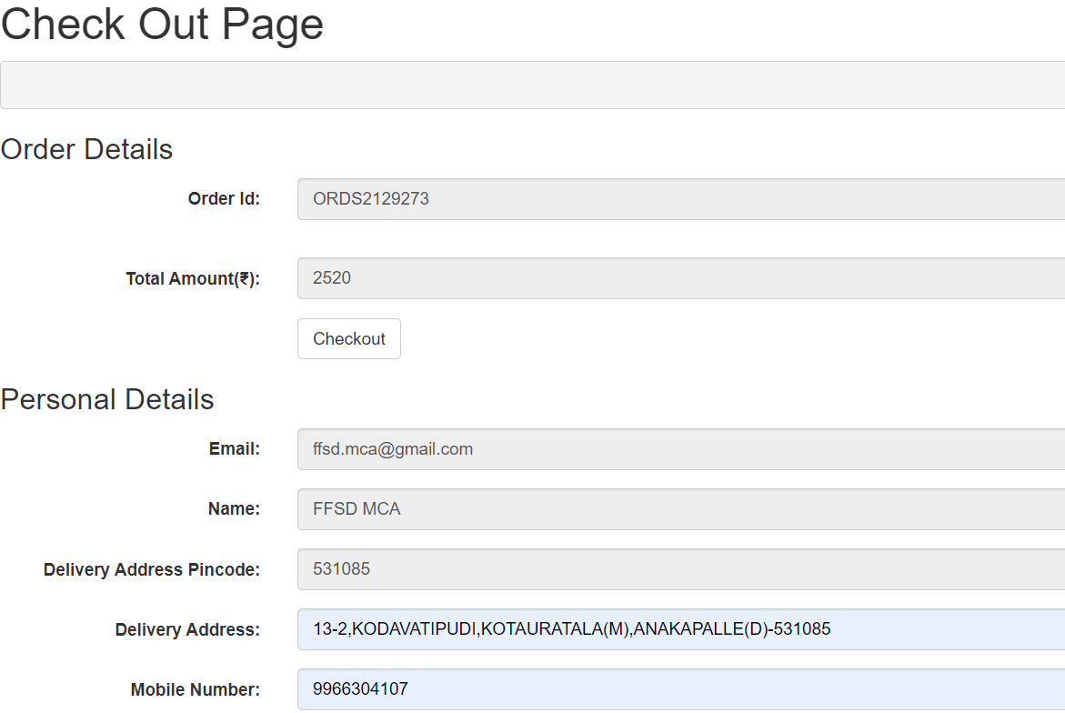
Customer /Home/Products/Cement/Checkout:

Slide 36
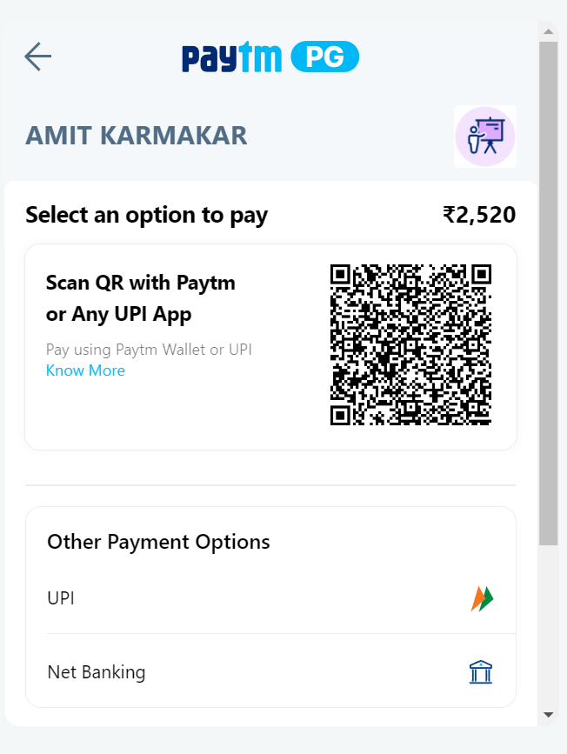
Customer /Home/Products/Cement/Checkout/Payment page:

Slide 37
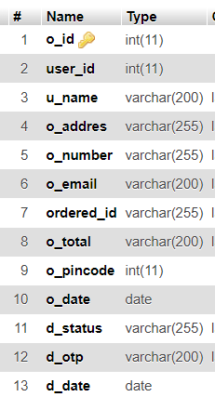
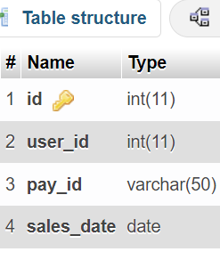
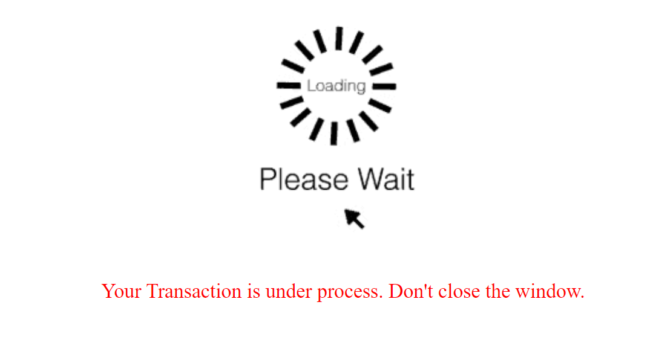
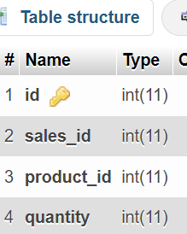
Customer /Home/Products/Cement/Checkout/Payment page Process:
Order Details Table Structure
Sales Table Structure
Details Table Structure

Slide 38
$payid = $_POST['pay'];
$date = date('Y-m-d');
$o_id =$_POST['o_id'];
$u_id =$_POST['u_id'];
$total =$_POST['total'];
$email =$_POST['email'];
$name =$_POST['name'];
$d_pincode =$_POST['d_pincode'];
$d_address =$_POST['d_address'];
$d_mobile =$_POST['d_mobile'];
$d_status=$_POST['d_status'];
$conn = $pdo->open();
try{
$stmt = $conn->prepare("INSERT INTO sales (user_id, pay_id, sales_date) VALUES (:user_id, :pay_id, :sales_date)");
$stmt->execute(['user_id'=>$user['id'], 'pay_id'=>$payid, 'sales_date'=>$date]);
$salesid = $conn->lastInsertId();
try{
$stmt = $conn->prepare("SELECT * FROM cart LEFT JOIN products ON products.id=cart.product_id WHEREuser_id=:user_id");
$stmt->execute(['user_id'=>$user['id']]);
foreach ($stmt as $row){
$stmt = $conn->prepare("INSERT INTO details (sales_id, product_id, quantity) VALUES (:sales_id, :product_id, :quantity)");
$stmt->execute(['sales_id'=>$salesid, 'product_id'=>$row['product_id'], 'quantity'=>$row['quantity']]);}

Slide 39
$stmt = $conn->prepare("DELETE FROM cart WHERE user_id=:user_id");
$stmt->execute(['user_id'=>$user['id']]);
code stock update after purchase
$stmt = $conn->prepare("select * FROM products WHERE id=:id");
$stmt->execute(['id'=>$row['product_id']]);
$row1 =$stmt->fetch();
$stock= $row1['stock'];
$stock= $stock-$row['quantity'];
$stmt = $conn->prepare("UPDATE products SET stock =:stock WHERE id =:id");
$stmt->execute(['stock'=>$stock, 'id'=>$row['product_id']]);
//order_deatils query
$stmt = $conn->prepare("INSERT INTO order_details (sales_id, user_id, u_name, o_addres, o_number, o_email, ordered_id, o_total, o_pincode, o_date, d_status) VALUES (:sales_id, :user_id, :u_name, :o_addres, :o_number,:o_email, :ordered_id, :o_total,:o_pincode,:o_date,:d_status)");
$stmt->execute(['sales_id'=> $salesid ,'user_id'=>$u_id, 'u_name'=>$name, 'o_addres'=>$d_address,'o_number'=>$d_mobile, 'o_email'=>$email, 'ordered_id'=>$o_id,'o_total'=>$total ,'o_pincode'=>$d_pincode,'o_date'=>$date,'d_status'=>$d_status]);
$_SESSION['success'] = 'Transaction successful. Thank you.’;
}

Slide 40
catch(PDOException $e){
$_SESSION['error'] = $e->getMessage();
}
}
catch(PDOException $e){
$_SESSION['error'] = $e->getMessage();
}
$pdo->close();
}

Slide 41
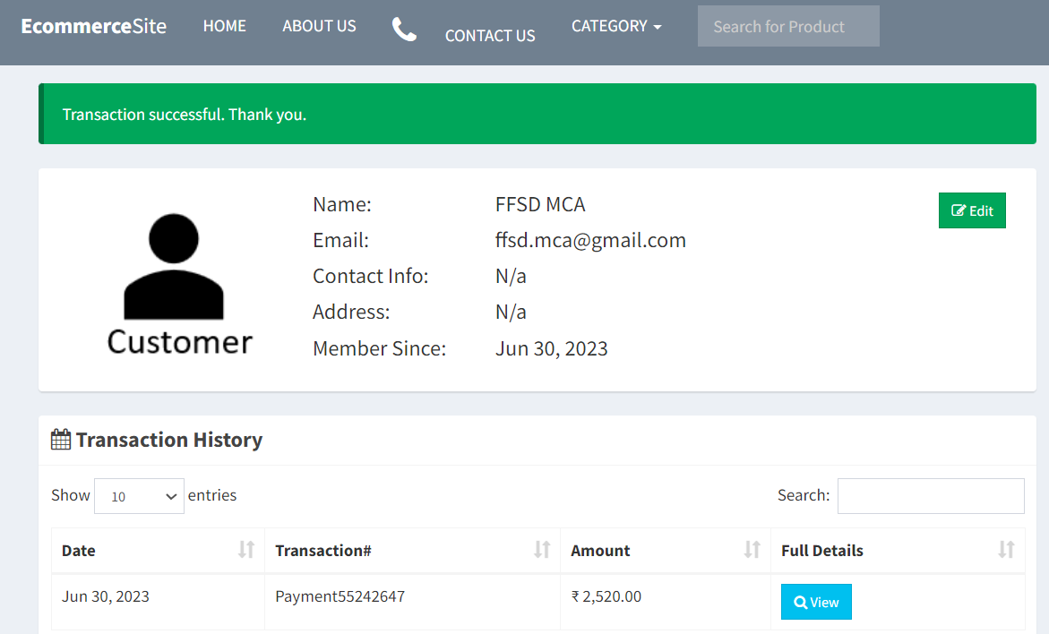
Customer /Home/Transaction History:

Slide 42
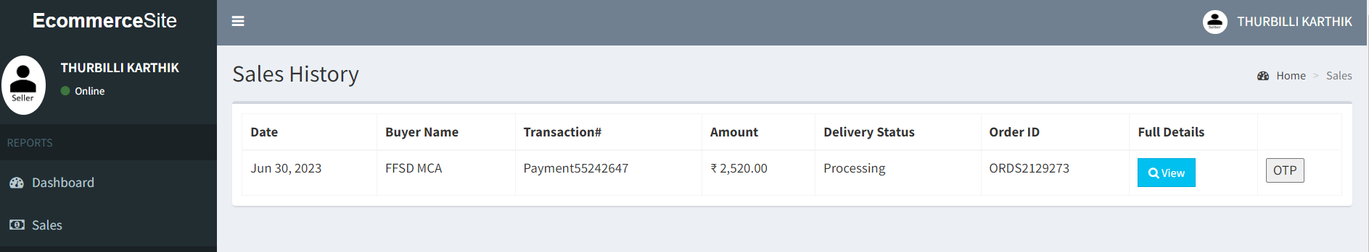
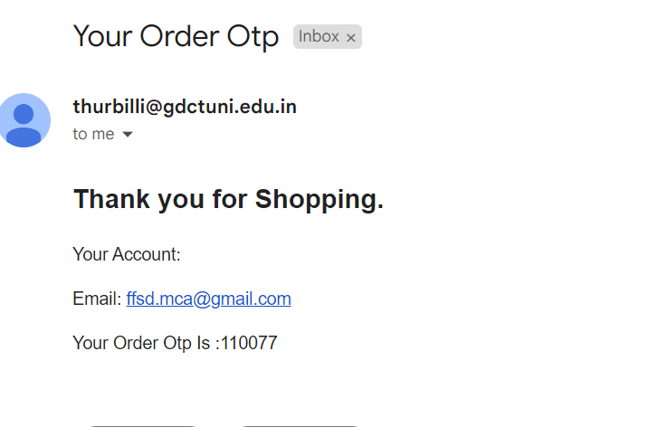
Seller/Home/Sales/ Place Order
Customer Email

Slide 43
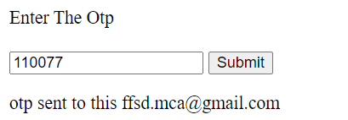
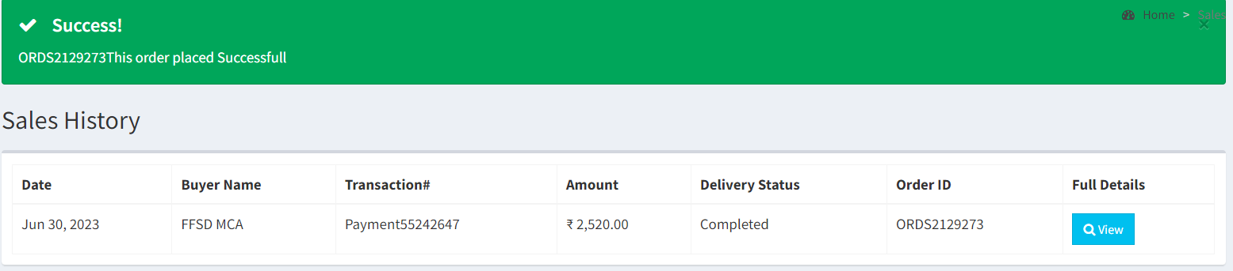
Seller/Home/Sales/ Verify the Delivery & Place Order:

Slide 44
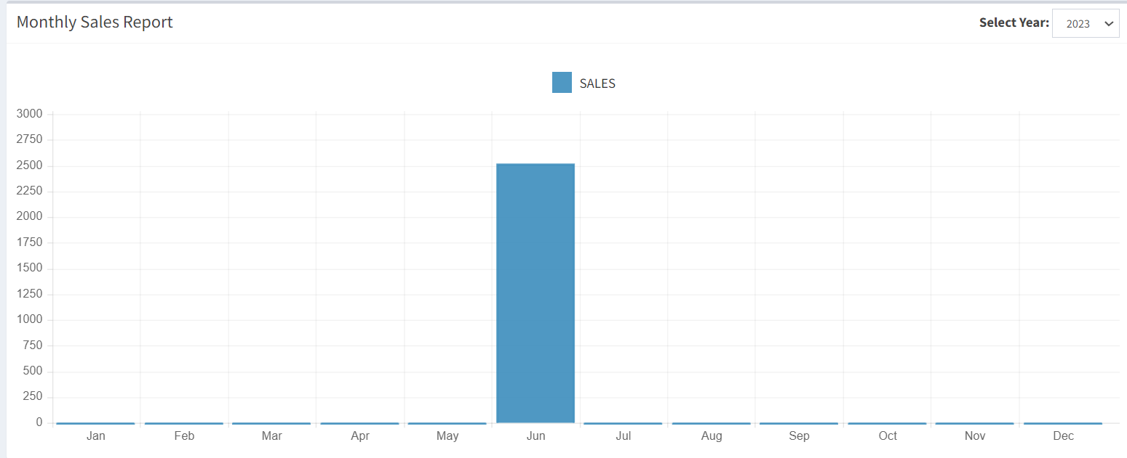
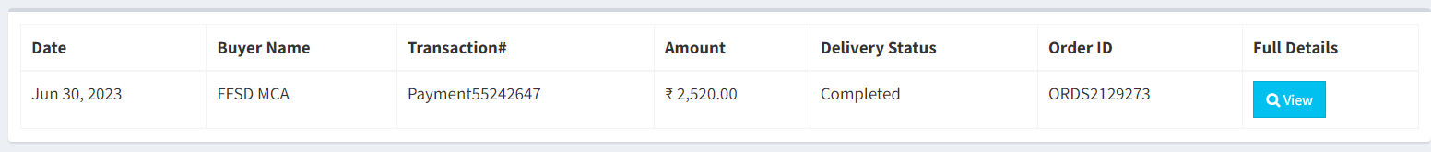
Seller/Home/Sales Report

Slide 45
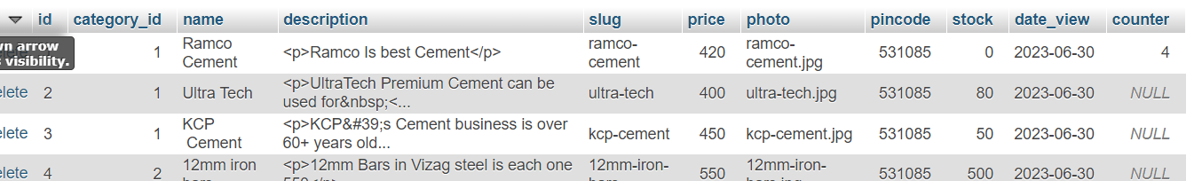
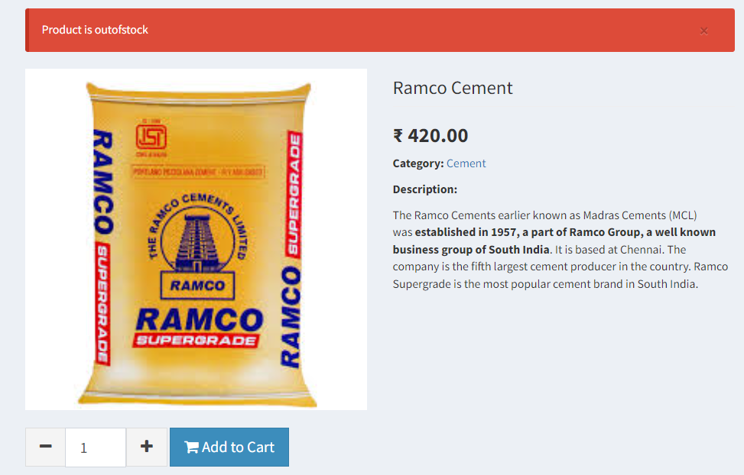
Customer /Home/Products/Cement/Out of Stock:
Products Table Data

Slide 46
Conclusion
This website provides a basic facilities of e-commerce. which will benefit the Customers as well as the Sellers. It makes entire process online where Customer can search Products based on area pin code.
The complete monitoring access is given to the seller only.
The Seller can be able to maintain all the data that includes information about categories, products, users, transactions, delivery, and total sales in a month. Customer can be able to know the availability of products, they can view the details of the products , and the system will display the recent most viewed products, Customer can buy the products easy manner.
The system is designed in a user-friendly manner.

Slide 47
References
Websites:
[1] https://www.materialtree.com/
[2] https://www.buildersmart.in/
[3] https://www.rodidust.com/
[4] https://github.com/paytm/Paytm_PHP_Checksum
[5] https://www.tawk.to/
[6] https://myaccount.google.com

Slide 48
Thank You

